Slide 1

The Future of Package Tracking
Saranyo Ray 22BCE3097
Yash Mathur 22BCE3119
Ankit Dey 22BCE3177

Slide 2
PROBLEM STATEMENT
Increasing e-commerce and logistics demands mean more packages are in transit, which leads to issues such as mishandling, damage, and unauthorized tampering. Fragile and high-value shipments are particularly vulnerable to impacts, improper orientation, or security breaches during transport.

Slide 3
OUR SOLUTION
Automatic Package Tracker for Monitoring, Security, and Damage Detection
We have developed an Automatic Package Tracker that integrates multiple sensors to continuously monitor a package’s location, condition, and security.
By providing real-time alerts on geographic location, orientation shifts (via gyroscope), temperature and moisture changes, and any tampering events, our product directly addresses the shortcomings of conventional tracking systems.

Slide 4
ARCHITECTURE
The architecture is built around a microcontroller that collects data from various sensors.
A GPS module tracks the package’s real-time location, allowing both the sender and recipient to monitor its journey.
A gyroscope monitors the package’s orientation, detecting any improper handling
A temperature-humidity sensor ensures that environmental conditions remain within safe limits.
The microcontroller processes this data and uses a Wi-Fi transmitter to send real-time updates to a server for monitoring.
This setup also supports alerts for any orientation shifts, environmental fluctuations, or potential tampering.
Together, these components provide comprehensive tracking and protection for sensitive shipments.

Slide 5
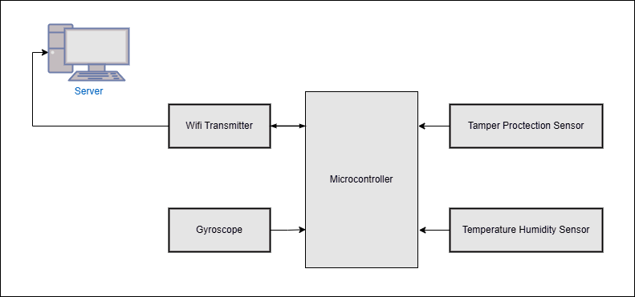
ARCHITECTURE

Slide 6

What it does?
Our Automatic Package Tracker offers real-time monitoring of a package’s journey using GPS, allowing both sender and recipient to track its location accurately.
It detects mishandling, such as crashes, vibrations, tilting, or being turned upside down—ideal for protecting fragile or high-value items.
Security sensors detect tampering, including seal breaking or unauthorized opening, and send instant alerts to ensure the package remains safe throughout transit.

Slide 7

Features and functions
Tamper Sensing
Crash Sensing
They identify unauthorized openings, broken seals, or cut tape. Instant notifications are sent to secure the package during transit.
It detects any changes in orientation, signaling if the package is flipped. Alerts are triggered to prevent mishandling of fragile items.
GPS tracking
Temperature and Moisture Sensing
Our system offers real-time location updates for both sender and recipient. This ensures transparent monitoring of package movement.
It continuously monitors ambient conditions to protect sensitive goods. Safe thresholds are maintained to prevent spoilage or damage.

Slide 8
Thank You

